Slide 1

CAPSTONE PROJECT ecommerce_product_performance
Machine learning project
Presented By
Student Name:N.karthik sai manikanta
College Name:Aditya university
Department:MCA
Email ID: nunnakarthik791@gmail.com (small letters)
AICTE Student ID: STU66b0f458521b11722872920

Slide 2
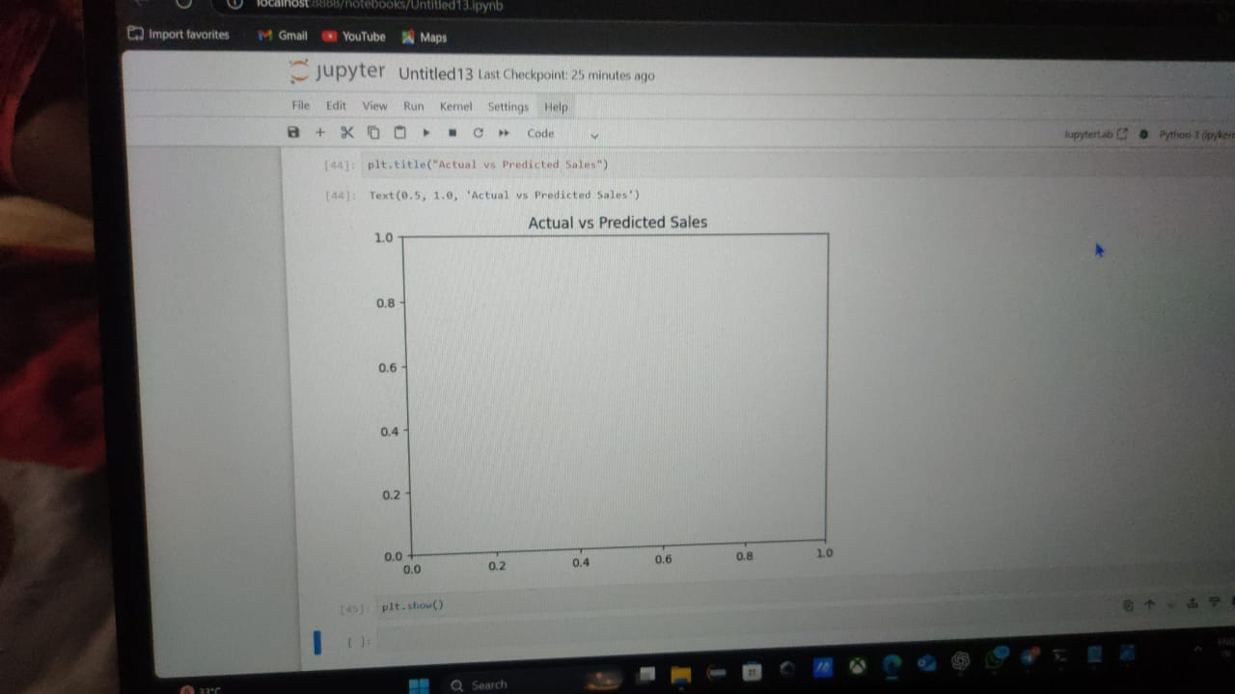
OUTLINE
Problem Statement Analyze e-commerce product data to identify sales trends, evaluate product performance, and predict future sales, helping businesses improve inventory, marketing, and sales strategies. ()
Proposed System/Solution Leverages machine learning to analyze historical sales data and predict future product demand in e-commerce.
System Development Approach (Utilizes Python, Pandas, and Scikit-learn for data preprocessing, analysis, and building machine learning models.)
Algorithm & Deployment Would you like helUses a Random Forest algorithm for prediction and deploys the model using a web-based interface for user interaction.
Result ()

Slide 3
Conclusion :
The system effectively analyzes product performance and predicts future sales, enabling better decision-making in e-commerce.
Future Scope
The system can be enhanced with real-time data integration and deep learning models for more accurate and dynamic predictions
References Scikit-learn: Machine Learning in Python — Pedregosa et al., Journal of Machine Learning Research, 2011.

Slide 4
Problem Statement
E-commerce businesses face difficulty in identifying which products are performing well or poorly due to large and complex datasets.
There is a need to analyze product performance data to uncover trends and make accurate sales predictions for improved decision-making.
Would you like the same for other sections like Objectives or Methodology?
You need GPT-4o to continue this chat because there's an attachment. Your limit resets after 7:59 PM.

Slide 5
Proposed Solution
The proposed system aims to address the challenge of predicting the required bike count at each hour to ensure a stable supply of rental bikes. This involves leveraging data analytics and machine learning techniques to forecast demand patterns accurately. The solution will consist of the following components:
Data Collection:
Gather historical data on bike rentals, including time, date, location, and other relevant factors.
Utilize real-time data sources, such as weather conditions, events, and holidays, to enhance prediction accuracy.
Data Preprocessing:
Clean and preprocess the collected data to handle missing values, outliers, and inconsistencies.
Feature engineering to extract relevant features from the data that might impact bike demand.
Machine Learning Algorithm:
Implement a machine learning algorithm, such as a time-series forecasting model (e.g., ARIMA, SARIMA, or LSTM), to predict bike counts based on historical patterns.
Consider incorporating other factors like weather conditions, day of the week, and special events to improve prediction accuracy.
Deployment:
Develop a user-friendly interface or application that provides real-time predictions for bike counts at different hours.
Deploy the solution on a scalable and reliable platform, considering factors like server infrastructure, response time, and user accessibility.
Evaluation:
Assess the model's performance using appropriate metrics such as Mean Absolute Error (MAE), Root Mean Squared Error (RMSE), or other relevant metrics.
Fine-tune the model based on feedback and continuous monitoring of prediction accuracy.
Result:

Slide 6
System Approach
The "System Approach" section outlines the overall strategy and methodology for developing and implementing the rental bike prediction system. Here's a suggested structure for this section:
System requirements
The system requires modern hardware, including a multi-core processor (Intel i5 or higher), 8 GB of RAM, and at least 50 GB of storage. Software requirements include Python (3.6+), an IDE such as Jupyter Notebook or Google Colab, and a database like PostgreSQL for storing rental data.
Library required to build the model
Essential libraries include Pandas for data manipulation, Scikit-learn for building machine learning models, and Matplotlib/Seaborn for data visualization. Additional libraries like XGBoost and TensorFlow/Keras may be used for enhanced model performance and predictions.

Slide 7
Algorithm & Deployment
In the Algorithm section, describe the machine learning algorithm chosen for predicting bike counts. Here's an example structure for this section:
Algorithm Selection:
Provide a brief overview of the chosen algorithm (e.g., time-series forecasting model, like ARIMA or LSTM) and justify its selection based on the problem statement and data characteristics.
Data Input:
Specify the input features used by the algorithm, such as historical bike rental data, weather conditions, day of the week, and any other relevant factors.
Training Process:
Explain how the algorithm is trained using historical data. Highlight any specific considerations or techniques employed, such as cross-validation or hyperparameter tuning.
Prediction Process:
Detail how the trained algorithm makes predictions for future bike counts. Discuss any real-time data inputs considered during the prediction phase.

Slide 8
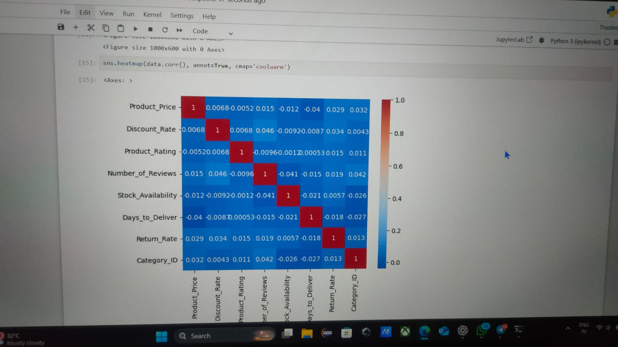
Result
Present the results of the machine learning model in terms of its accuracy and effectiveness in predicting bike counts. Include visualizations and comparisons between predicted and actual counts to highlight the model's performance.

Slide 9
Conclusion
Identification of Key Performance Drivers: The analysis reveals that specific product attributes, such as price, category, and customer ratings, significantly influence sales performance. Understanding these drivers enables businesses to optimize product listings and target marketing efforts more effectively.

Slide 10
Future scope
The feature scope of this project includes analyzing key attributes such as product category, price, customer ratings, stock availability, and promotional discounts to understand their impact on sales performance. By incorporating these features, the analysis aims to identify trends, optimize inventory, and forecast future sales, thereby enhancing overall business strategies for e-commerce platforms.

Slide 11
References
List and cite relevant sources, research papers, and articles that were instrumental in developing the proposed solution. This could include academic papers on bike demand prediction, machine learning algorithms, and best practices in data preprocessing and model evaluation.
GitHub Link: NKarthiksai/machine-learning-aicet-project
https://github.com/NKarthiksai/machine-learning-aicet-project

Slide 12
Thank you

